Slide 1
NLP

Slide 2
Natural language processing (NLP)
Natural language processing (NLP) refers to the branch of computer science—and more specifically, the branch of artificial intelligence or AI—concerned with giving computers the ability to understand text and spoken words in much the same way human beings can.

Slide 3
Example
Is the desired solution a state of the world or a path to a state?
Finding a consistent interpretation for the sentence
The bank president ate a dish of pasta salad with the fork
Problems whose solutions is a path
Eg: Water jug problem

Slide 4
Frames
Frames are an artificial intelligence data structure used to divide knowledge into substructures by representing "stereotyped situations".

Slide 5
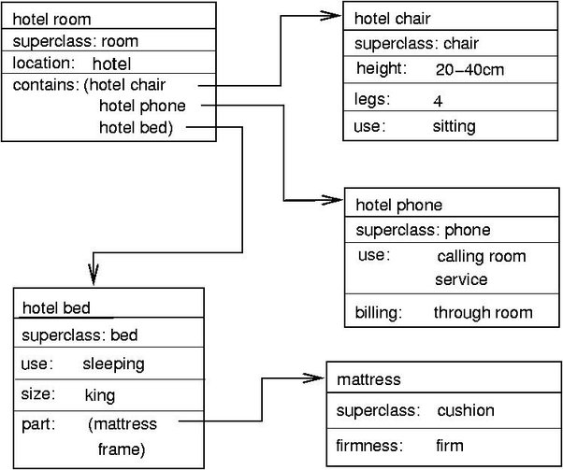

Slide 6
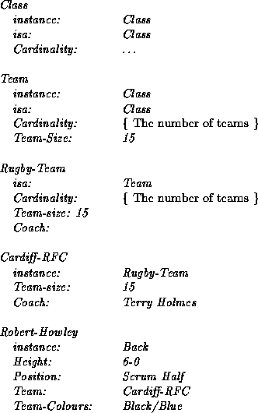

Slide 7
Dependency directed backtracking
Eg:
All birds fly
Crow is a bird
Whether crows can fly???
Penguin is a bird
Whether penguins can fly???
Penguins cannot fly
Whether dead birds can fly???

